Slide 1
Commands in MATLAB to obtain the solution of Ordinary Differential Equations (ODE) and System of ODEs
Lecture-4

Slide 2
Specific aims
Discuss about the System of Equations and Higher Order Differential Equations
Solve ODEs and System of ODEs using MATLAB commands
Examples
Multiple questions
Exercises

Slide 3
Background
System of Equations
Consider a system of pair of equations
subject to initial conditions,
(i) Euler’s Method for a System
Euler’s method to the above system can be written as

Slide 4
(ii) Rk-2 Method for a System
The second order Runge-Kutta (RK-2) method to the above system can be written in the form
And
In a similar way RK-4 method can be extended for system of equations. An ordinary differential equation of order higher than 1 can be solved numerically by changing it into a system of first order equations.

Slide 5
Higher Order Differential Equations
The Taylor series solution for higher order differential equations is straightforward and similar to first order equation.
An ordinary differential equation of order higher than 1 can be solved numerically by changing it into a system of first order equations. Consider, for example, a second order initial value problem
Defining the new variable
The above initial value problem can be written as

Slide 6
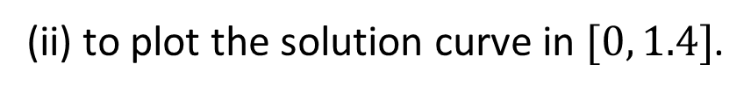
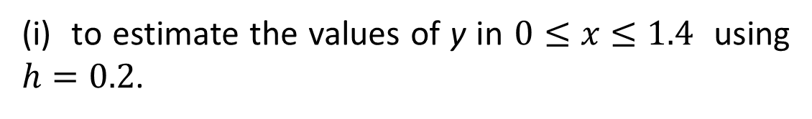
Examples
Question 1#:
Given that $y^{′}=2xy^{2}−y$, where $y=1 at x=0$.
Use MATLAB function “[x1, y1]=ode23(f, [x0, xn], y0)”
(i) to estimate the values of y in $0≤x≤1.4$ using $h=0.2$.
(ii) to plot the solution curve in $[0, 1.4]$.
Solution:
Given equation, $y^{′}=2xy^{2}−y$, where $y=1 at x=0$.

Slide 7
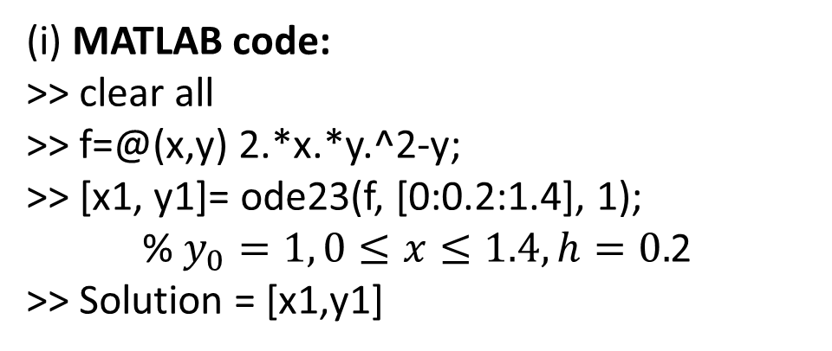
Output:
(i) MATLAB code:
>> clear all
>> f=@(x,y) 2.*x.*y.^2-y;
>> [x1, y1]= ode23(f, [0:0.2:1.4], 1);
% $y_{0}=1, 0≤x≤1.4, h=0.$2
>> Solution = [x1,y1]
Solution =
x y
0 1.0000
0.2000 0.8484
0.4000 0.7644
0.6000 0.7257
0.8000 0.7275
1.0000 0.7799
1.2000 0.9253
1.4000 1.3401

Slide 8
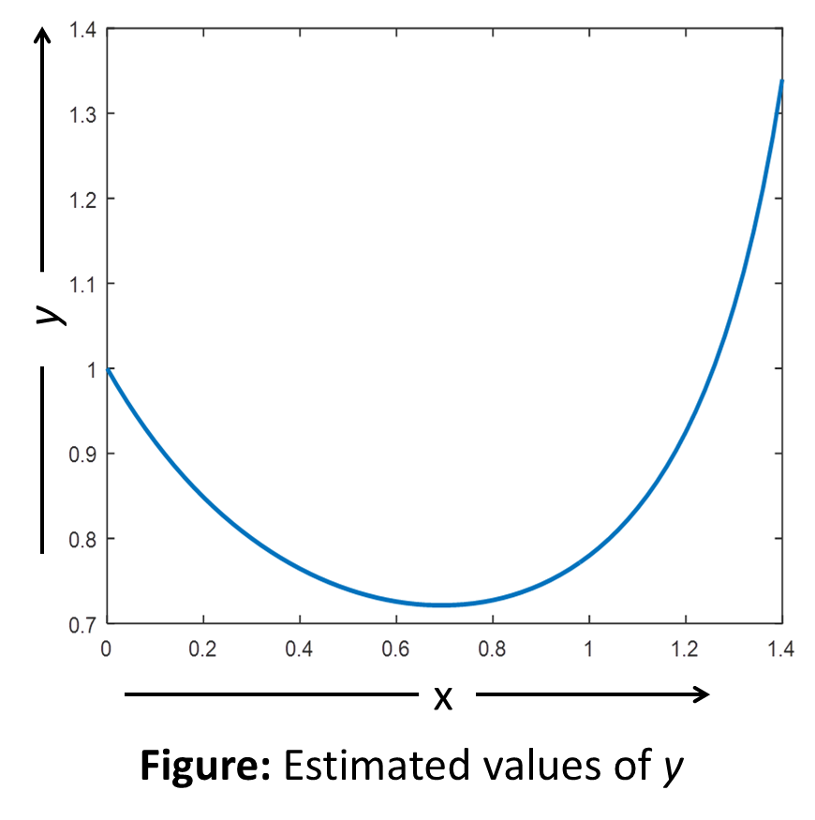
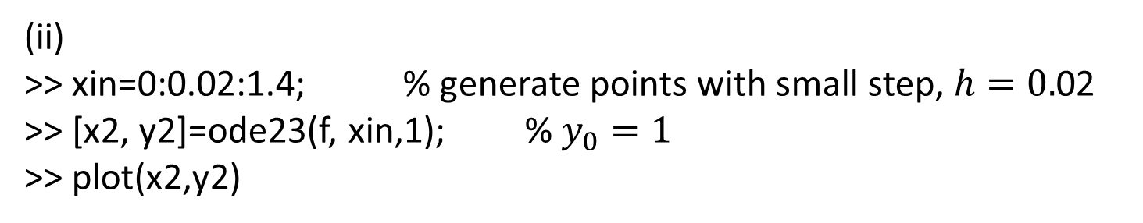
(ii)
>> xin=0:0.02:1.4; % generate points with small step, $h=0.$02
>> [x2, y2]=ode23(f, xin,1); % $y_{0}=1$
>> plot(x2,y2)

Slide 9
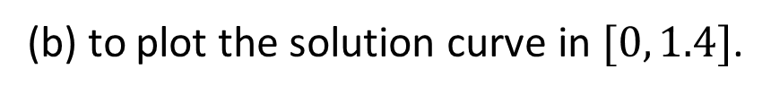
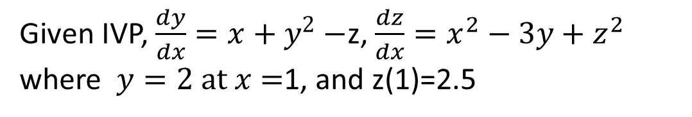
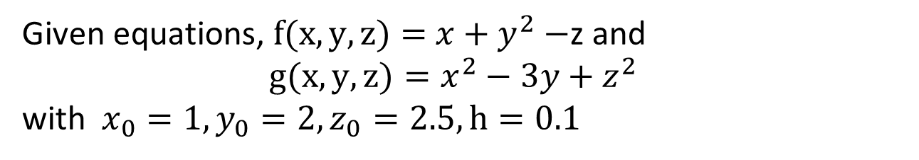
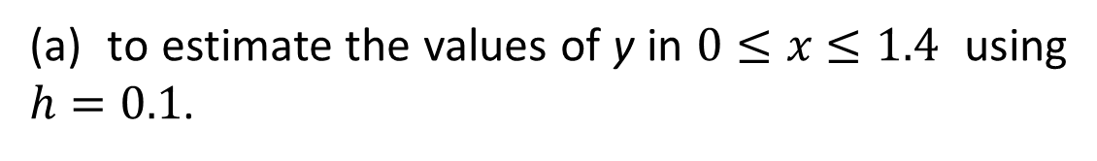
Question 2#:
Given IVP, $\frac{dy}{dx}=x+y^{2}−$z, $\frac{dz}{dx}=x^{2}−3y+z^{2}$
where $y=2 at x=$1, and z(1)=2.5
Use MATLAB function “[x1, y1]=ode45(F, [x0, xn], y0)”
(a) to estimate the values of y in $0≤x≤1.4$ using $h=0.1$.
(b) to plot the solution curve in $[0, 1.4]$.
Solution:
Given equations, $f(x,y,z)=$ $x+y^{2}−$z and
$g(x,y,z)=x^{2}−3y+z^{2}$
with $x_{0}=1, y_{0}=2, z_{0}=2.5, h=0.1$

Slide 10
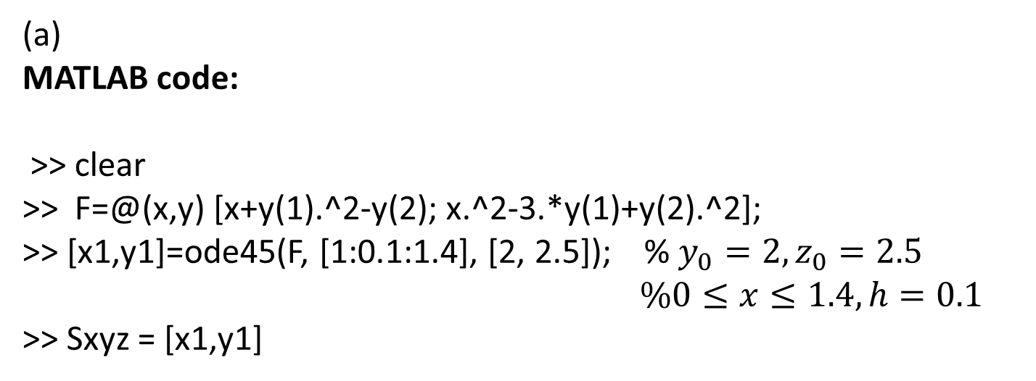
(a)
MATLAB code:
>> clear
>> F=@(x,y) [x+y(1).^2-y(2); x.^2-3.*y(1)+y(2).^2];
>> [x1,y1]=ode45(F, [1:0.1:1.4], [2, 2.5]); % $y_{0}=2, z_{0}=2.5$
$\%0≤x≤1.4, h=0.1$
>> Sxyz = [x1,y1]
Output:
Sxyz =
x y z
1.0000 2.0000 2.5000
1.1000 2.3091 2.6241
1.2000 2.8009 2.7112
1.3000 3.6825 2.6368
1.4000 5.6417 2.0508

Slide 11
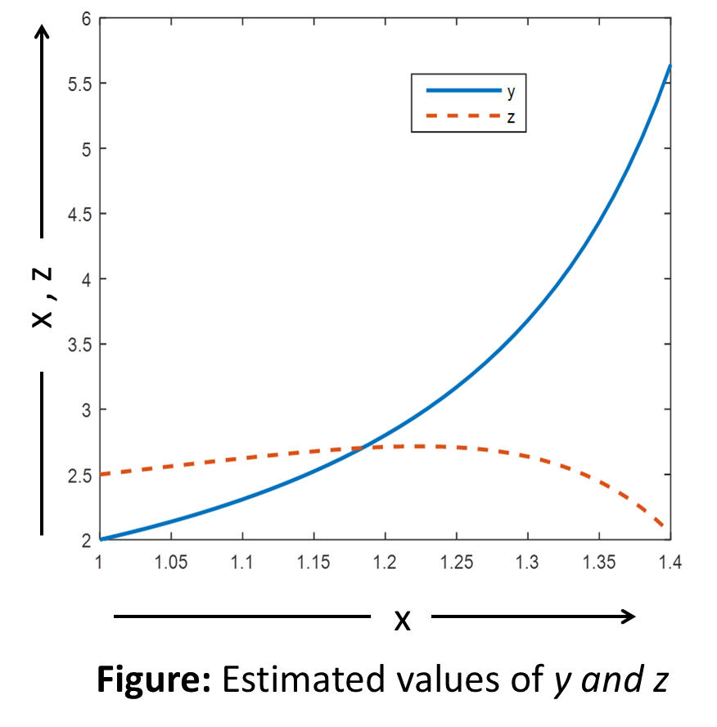

(b) MATLAB code:
>> [x2,y2]=ode45(F, [1:0.01:1.4], [2, 2.5]);
>> plot(x2,y2)
$$\% h=0.1,0≤x≤1.4$$

Slide 12
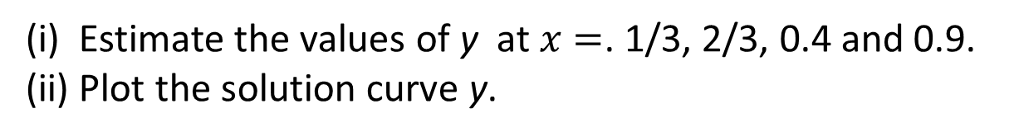
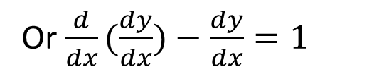
Question 2#:
Consider the boundary value problem (BVP)
$$y^{′′}−y^{′}=1, y\left(0\right)=1, y(1)=2\left(e−1\right)$$
Use MATLAB function “sol=bvp4c(odefun, bcfun, solinit)” to the BVP.
(i) Estimate the values of y at $x=$. 1/3, 2/3, 0.4 and 0.9.
(ii) Plot the solution curve y.
Solution:
Given that,
$$y^{′′}−y^{′}=1, y\left(0\right)=1, y(1)=2\left(e−1\right)$$
Or $\frac{d}{dx}(\frac{dy}{dx})−\frac{dy}{dx}=1$

Slide 13
MATLAB code:
>> clear
>> F=@(x,y) [y(2); 1+y(2)]; % dy/dx = F(x, y)
>> bc=@(ya,yb) [ya(1)-1; yb(1)-2*(exp(1)-1)]; % format Boundary
values
>> yinit=@(x) [1; 4]; % initial guess value supplied
>> solinit=bvpinit(linspace(0,1,3), [1,2]); % generates starting values
>> sol=bvp4c(F, bc, solinit); % solution

Slide 14
(i) % Extracting values from solution “sol”
>> xint=[0, 1/3, 2/3, 1];
>> sxint=deval(sol,xint)
Output:
Val_xy =
x y
0 1.0000
0.3333 1.4579
0.6667 2.2283
1.0000 3.4366

Slide 15
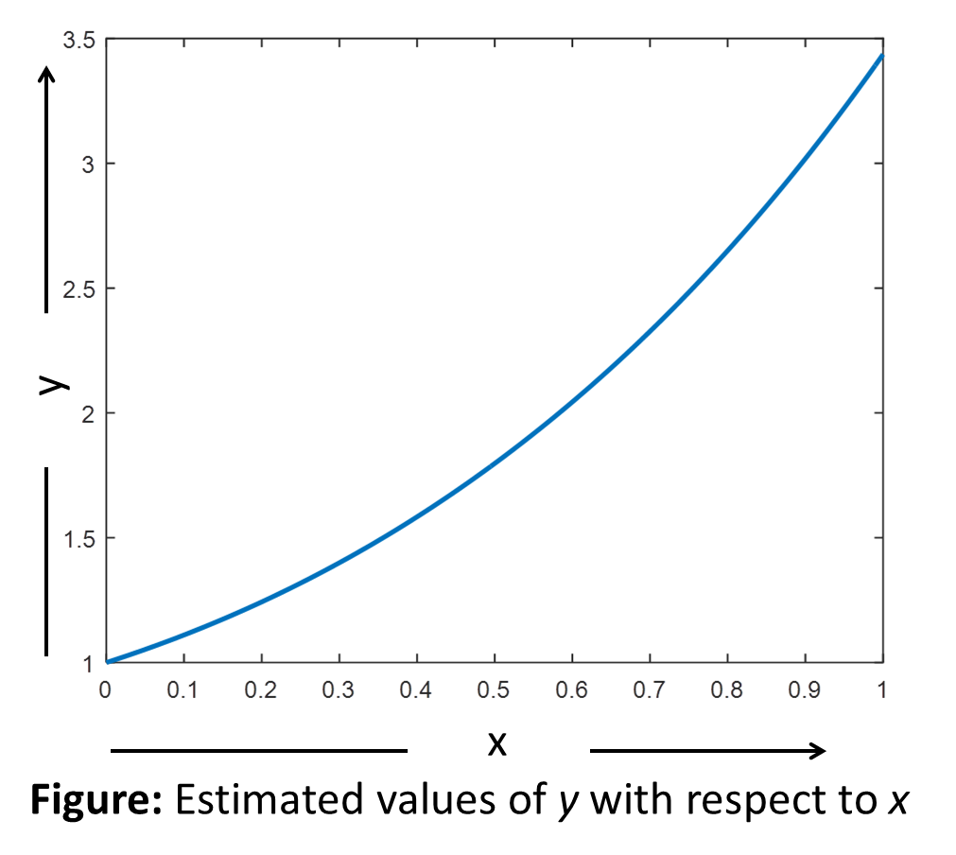
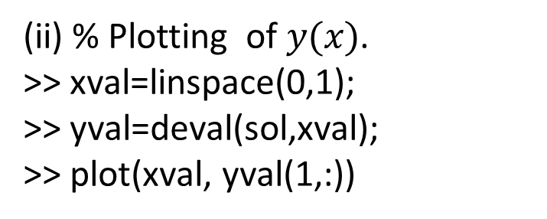
(ii) % Plotting of $y(x)$.
>> xval=linspace(0,1);
>> yval=deval(sol,xval);
>> plot(xval, yval(1,:))

Slide 16
Outcomes
Numerically solve problems by using commands in MATLAB
Visualization problems by plotting graphs
Save time for solving problems

Slide 17
Multiple questions:
S.No. | Questions
1 | An ordinary differential equation of order higher than 1 can be solved numerically by changing it into- a system of first order equations, a system of second order equations, Both of them, None of them
2 | Which is refers to solve ODE by following command in MATLAB? ode23s(f, [x0, xn], y0), ode23(f, [x0, xn], y0), ode13(f, [x0, xn], y0)
3 | Which one refers to solve ODE by following command in MATLAB? ode45(F, [x0, xn], y0), ode45s(F, [x0, xn], y0) Both of them
4 | Which command refers to solve boundary value problem in MATLAB? bvp4c(odefun, bcfun, solinit), bvp4d(odefun, bcfun, solinit), None of them

Slide 18
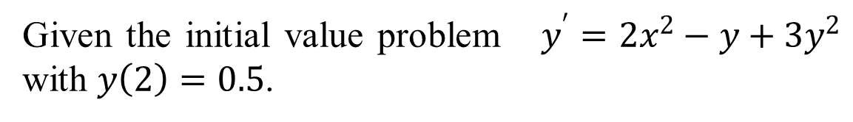
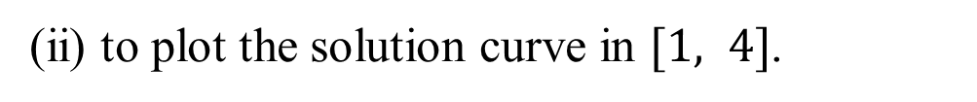
Try to do yourself
Exercise 1:
Given the initial value problem $y^{′}=2x^{2}−y+3y^{2}$ with $y\left(2\right)=0.5$.
Use MATLAB function “[x1, y1]=ode23(f, [x0, xn], y0)”
(i) to estimate the values of y in 1$≤x≤4$ using $h=0.2$.
(ii) to plot the solution curve in $[1, 4]$.
Exercise 2:
Given the system
with the initial conditions $y\left(1\right)=−1$ and .$z\left(1\right)=1$.

Slide 19
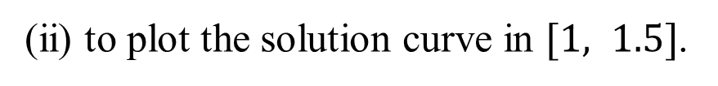
Use MATLAB function “[x1, y1]=ode45(F, [x0, xn], y0)”
(i) to estimate the values of y in $1≤x≤1.5$ using $h=0.1$.
(ii) to plot the solution curve in $[1, 1.5]$.
Reference
[1] Applied Numerical Methods With Matlab for Engineers and Scientists ( Steven C.Chapra).

